Slide 1
AI Privacy
Frameworks
Group Members: Stefan, Dui, Ruike, Madison

Slide 2
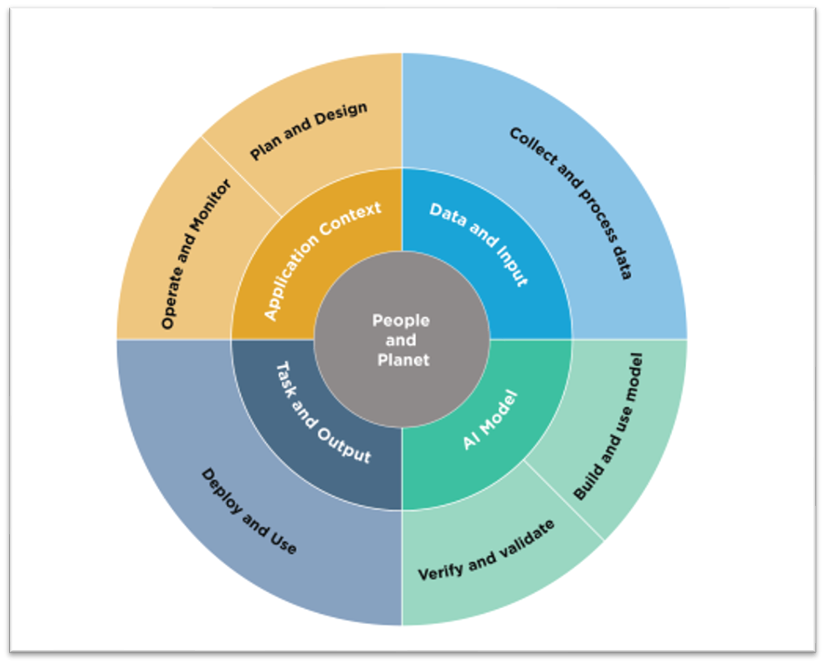
Introduction
With the increase of AI systems, there has been an increase of concern regarding privacy, surveillance, and misuse of AI tools. This concerns arise from the large-scale data collection that AI companies use to train their LLMs and how unrestricted LLMs are leading to misuse by users. Due to this, AI privacy frameworks have been created to ensure that users practice safe use of AI tools so that their private information remains secure.

Slide 3
Key Questions and Objectives
Why are AI Privacy Frameworks important?
How are AI Privacy Frameworks used?
What are the key elements that are discussed in AI Privacy Frameworks?
How do AI Privacy Frameworks protect users?
What are the most popular AI Privacy Frameworks and what benefits do they bring to the table
Protecting Individual Privacy Rights
Ensure Transparency
Mitigating Risks and Harmful attributes
Promoting Accountability
Encouraging Ethical Use
Supporting Security and Data Integrity

Slide 4
Addressing Key Questions:
Why are AI Privacy Frameworks important? - They address ethical, legal, and societal challenges posed by the rapid advancement of artificial intelligence.
How are AI Privacy Frameworks used? - Used as a structured guidelines in order to ensure that AI systems handle data responsibly, comply with regulations, and protect user privacy.
What are the key elements that are discussed in AI Privacy Frameworks? - Data Governance and Accountability, Transparency, Data and Purpose limitation, Privacy Enhanced technology, User Rights and Control, Risk Assessment and Mitigation, and Ethical and Societal Considerations, etc.

Slide 5
Continuing Addressing Key Questions
How do AI Privacy Frameworks protect users? - Prevent unauthorized data exploitation, safeguards data security, empowers user control, mitigates bias and discrimination in Large Language Models, ensure accountability, protects against surveillance, future proofs against emerging risks, etc.
What are the most popular AI Privacy Frameworks and what benefits do they bring to the table?
There are many popular and useful AI Privacy Frameworks but today we will be looking at the NIST summarized framework as a guideline to what a user should expect in a framework.

Slide 6
Other AI Privacy Frameworks
OECD AI Principles (Organization for Economic Co-operation and Development): Emphasizes privacy, fairness, transparency, and accountability in AI systems. Adopted by 46 countries as of right now.
EU AI Act: This was a major law passed by the European Union which classifies AI systems by risk and requires strict privacy protections from AI systems that are classified as high risk.
G7 Hiroshima AI Process: An agreement that was made recently by the G7 countries that align on a human-centric AI and also included strong privacy protection.
UNESCO Recommendation on the Ethics of Artificial Intelligence: A global framework that was signed by 193 countries and it focuses on protecting human rights including privacy and personal data protection in AI.
There are many more frameworks that are worth taking a look at since they all have different regulation and strategies for maintaining Artificial Intelligence as a safe tool for its users.

Slide 7
Other AI Privacy Frameworks
Canada’s Directive on Automated Decision-Making: Requires government AI systems to follow guidelines on respecting privacy and human rights. AI systems are also assigned a risk level depending on how well they follow the guidelines.
Singapore Model AI Governance Framework: A Singaporean governmental published guide that includes topics on privacy, explainability, accountability, and other measures for AI systems.

Slide 8
Similarities & Differences Between Frameworks
Think About:
What similarities and differences do you see between these frameworks?
Which frameworks do you think provide the most comprehensive protection?
Where do you see gaps or weaknesses in these frameworks?

Slide 9
Sample AI Privacy Framework
Disclaimer: This is only a summarized version of the NIST AI privacy framework. The document to the whole framework can be found in the linked document in references. For a more extensive deep dive on key elements I would recommend browsing certain parts of the document.
Background: NIST stands for the National Institute of Standards and Technology. They created a framework to be used as a helping guideline for users using LLM tools. As generative AI tools started to expand there was growing need for clear privacy standards. Due to this, the NIST decided to create the AI Risk Management Framework (AI RMF) in 2023 which heavily focuses on privacy protection.

Slide 10
Sample AI Privacy Framework Purpose
Purpose: The NIST AI RMF is a voluntary guidance framework designed to help organizations develop, deploy, and use trustworthy AI systems by identifying and managing risk. This includes privacy, bias and discrimination, safety, and security. By following these frameworks, organizations can build AI systems that are effective and can also respect user’s rights, earn public trust, and also align with ethical standards. This framework is also designed to work alongside existing laws and policies all around the world.

Slide 11
Sample AI Privacy Framework Components
Structure of the Framework: The AI RMF has two main components that discuss the frameworks core and trust characteristics that should be analyzed and regulated within LLMs. The first part describes the Core Functions (Govern, Map, Measure, Manage), which guides organizations through the process of handling AI risks. The second part of this framework outlines the Trustworthiness characteristics that AI systems should have. Both of these components are very important when working with powerful tools like Large Language Models where many risks and threats exist to users.

Slide 12
Sample AI Privacy Framework Core
Govern - Establishes clear policies, roles, and procedures for managing AI risks across an organization. This will build a culture that values transparency, accountability, and responsibility when using AI.
Map - Intends for users to understand the AI systems intended purpose, environment, and how it interacts with people and other systems. Make sure to identify risks based on the context and user scenario.
Measure - Evaluate the risks associated with the AI system using both qualitative (descriptive) and quantitative (numerical) strategies. This allows the user to understand how serious or how likely each risk is.
Manage - Take steps to reduce, control, and monitor risks throughout the AI system’s life cycle. Update risk management plans regularly as the AI systems or its environment changes.

Slide 13
Sample AI Privacy Framework Trust Characteristics
The framework promotes the development of AI systems that are:
• Valid and Reliable
• Safe
• Secure and Resilient
• Accountable and Transparent
• Explainable and Interpretable
• Privacy-Enhanced
• Fair with Harm Mitigation

Slide 14
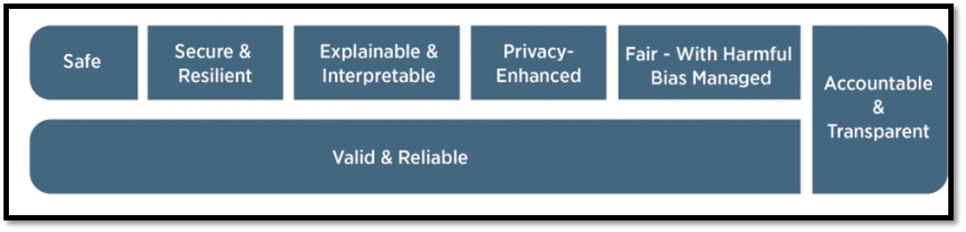
NIST Framework LLM Objective Diagram

Slide 15
Key Findings & Objectives Met
Key Findings: Analyzing NIST AI RMF we see that there are some important attributes that match our AI Privacy Framework
Objectives Met:
First Objective: We can see that framework ensures a privacy enhanced call to generative AI tools. It further pushes towards this objective with the secure resilient standard that is placed on AI generative tools.
Second Objective: Talked about in the framework as the framework puts a standard for accountability and transparency on companies that are developing and running LLM tools.

Slide 16
Objectives Met
Third Objective: Met through standards that are listed under the harm and mitigation standard. These standards make sure that AI tools cannot be exploited and used in a harmful way.
Fourth Objective: Represented in the framework under the accountability and transparency section where user and LLM companies are held responsible for any wrongdoings that the LLM does, or the user itself does.
Fifth Objective: Met through a multitude of standards ensuring that the LLM itself and users follow regulations to make LLM use and production ethical.
Sixth Objective: Met through the safe, secure, and resilient standard. It also includes the privacy enhancements that are measured on each LLM. These measures represents how safe using a certain LLM is and how to keep your data protected.

Slide 17
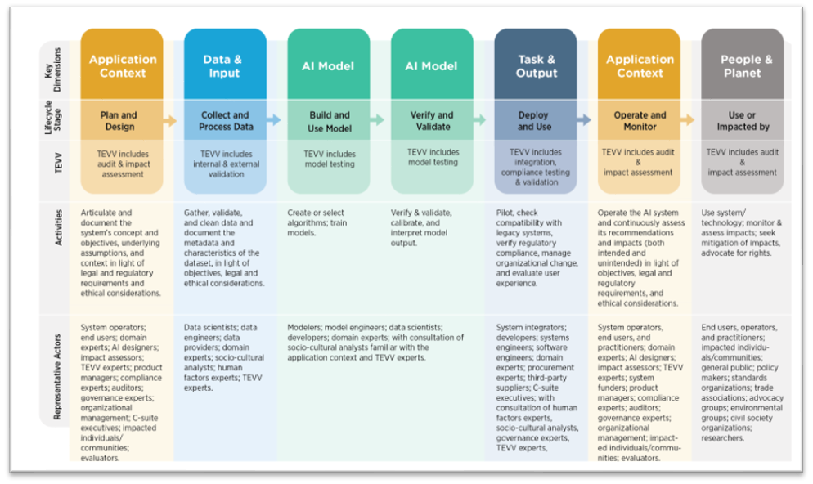
NIST Framework Diagram

Slide 18
Conclusion
NIST AI Privacy Framework is one of many AI privacy frameworks out there. The importance of these frameworks continue to increase day by day as LLM technology rapidly advances. The fundamentals and moral guidelines will maintain users' privacy while providing a list of responsibilities that the user themselves has too. As LLMs become more prominent there will have to be more descriptive frameworks to keep users safe. The NIST AI Privacy Framework is a great place to begin for many users to fully comprehend what future LLM training and usage should look like.

Slide 19
References
https://nvlpubs.nist.gov/nistpubs/ai/nist.ai.100-1.pdf
https://www.nist.gov/video/introduction-nist-ai-risk-management-framework-ai-rmf-10-explainer-video
https://www.dataprivacyframework.gov/list
https://ovic.vic.gov.au/privacy/resources-for-organisations/artificial-intelligence-and-privacy-issues-and-challenges/

Slide 20
Thank You!

